Slide 1
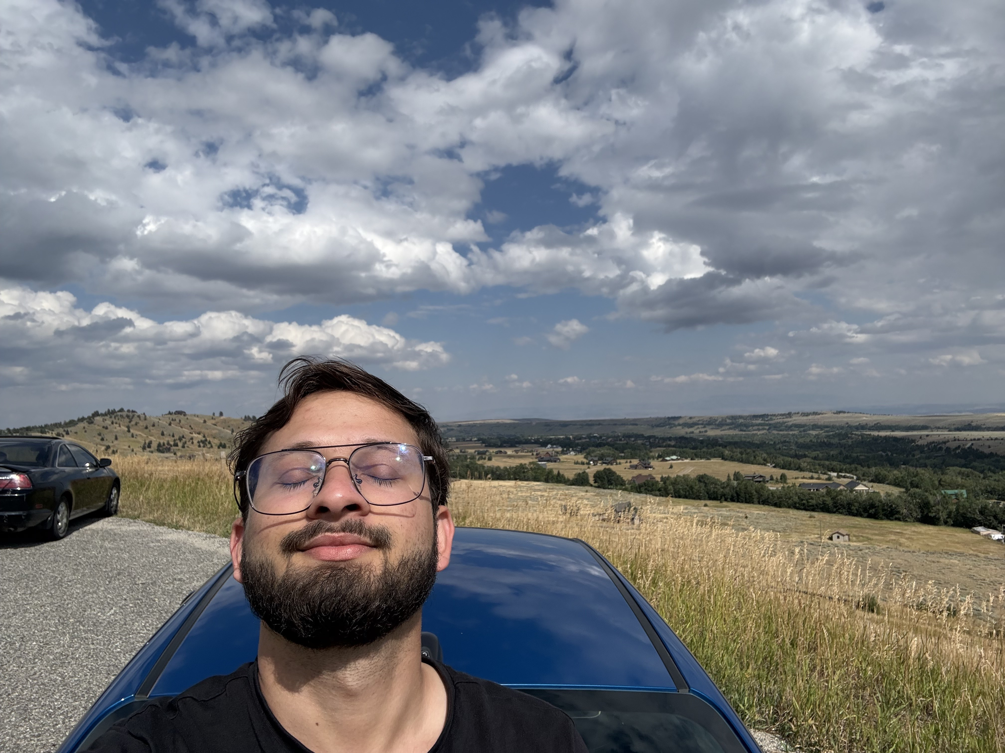

My Journey
Hi Everyone! I am Saurav Pokharel

Slide 2
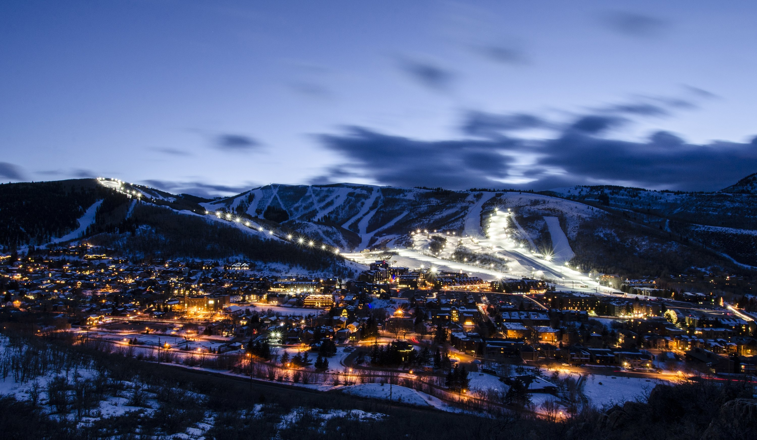
About me
I’m a computer science student for Weber State University.
Originally from Nepal, I love learning about technology, design and innovation.
In my free time, I enjoy exploring nature, creating designs and learning new coding skills.
Something unique about me is that I enjoy both creative design and technology. I like working on visual projects (graphic design) just as much as problem-solving and building things digitally. I’m always interested in learning new skills and improving what I already know.

Slide 3
My journey so far
Born and raised in Nepal
Worked as a graphic designer and tech assistant before coming to the U.S. Now exploring coding, web development and entrepreneurship.
In my free time, I enjoy designing, photography, editing, gaming, and working on creative projects. I also like exploring new tools and platforms that help with creativity and communication.

Slide 4


My Passions
Technology and creativity drive me.
I enjoy turning ideas into visual designs and solving real-world problems with code.
Currently working on personal web projects and a t-shirt printing business.

Slide 5
Like/ Dislike
I like clean design, creative collaboration, and learning new things. I dislike disorganization, unnecessary stress, and last-minute chaos (even though it sometimes still happens).

Slide 6

A Glimpse of my adventures
I love exploring Utah’s beauty, It reminds me of Nepal’s mountains.

Slide 7
Favorites:
Favorite way to relax: listening to music or working on a creative project
Favorite food: anything flavorful (especially comfort food)
Favorite activity: creating something from scratch and seeing it come together
Favorite way to relax: playing video games or working on a creative project
Favorite food: MoMo
Favorite activity: creating something from scratch and seeing it come together
I’m looking forward to learning more about communication this semester and working with everyone on the group project. Feel free to reach out—I’m excited to connect with you all!

Slide 8
Thank you!
Thank you for watching my story!
Connect with me: www.sauravpokharel.com.np
Always keep learning and creating!

